Slide 1
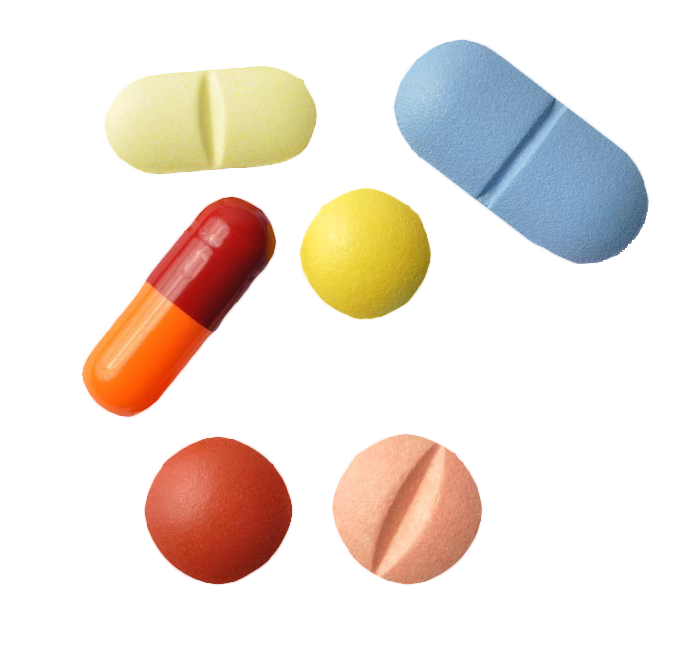
BUAN 6340
Prediction of Drug Abuse
Group project team members:
Qianying Li | Xinyi Chen | Hao Mei | Chuang Chen

Slide 2

01
Project Introduction
02
Data Exploration
03
Model Analysis
04
Prediction & Conclusion

Slide 3
01
Project Introduction
topic description | dataset description | sources

Slide 4
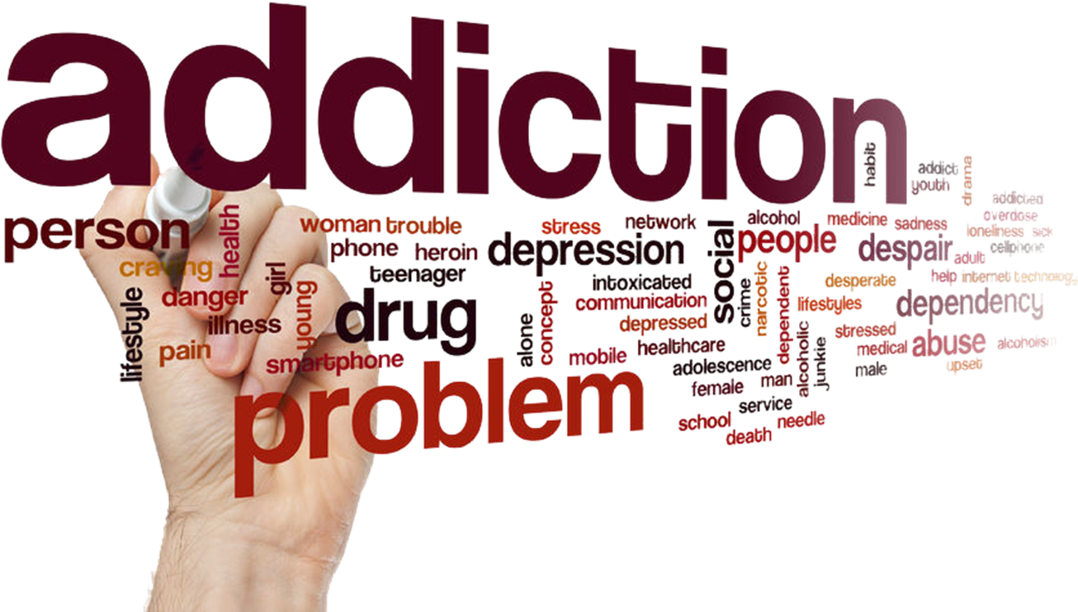
01
Project Introduction
A brief description of our topic
Addiction
Devastating health impact
An important factor for earlier mortality and morbidity
Significant consequences for our society.
01
Why This Topic?
Identifying drug-use risk allows targeted intervention to happen before a person may become susceptible to the highly addictive nature of drugs and the risk of potential overdose.
02
How Is It Important?
We expect to be able to answer questions such as:
Which age group has the highest number of drug use?
How personality traits and demographics affect drug consumption?
Is moody people (people who have a high Neuroticism score) more likely to abuse drugs?
03
Project Goals

Slide 5
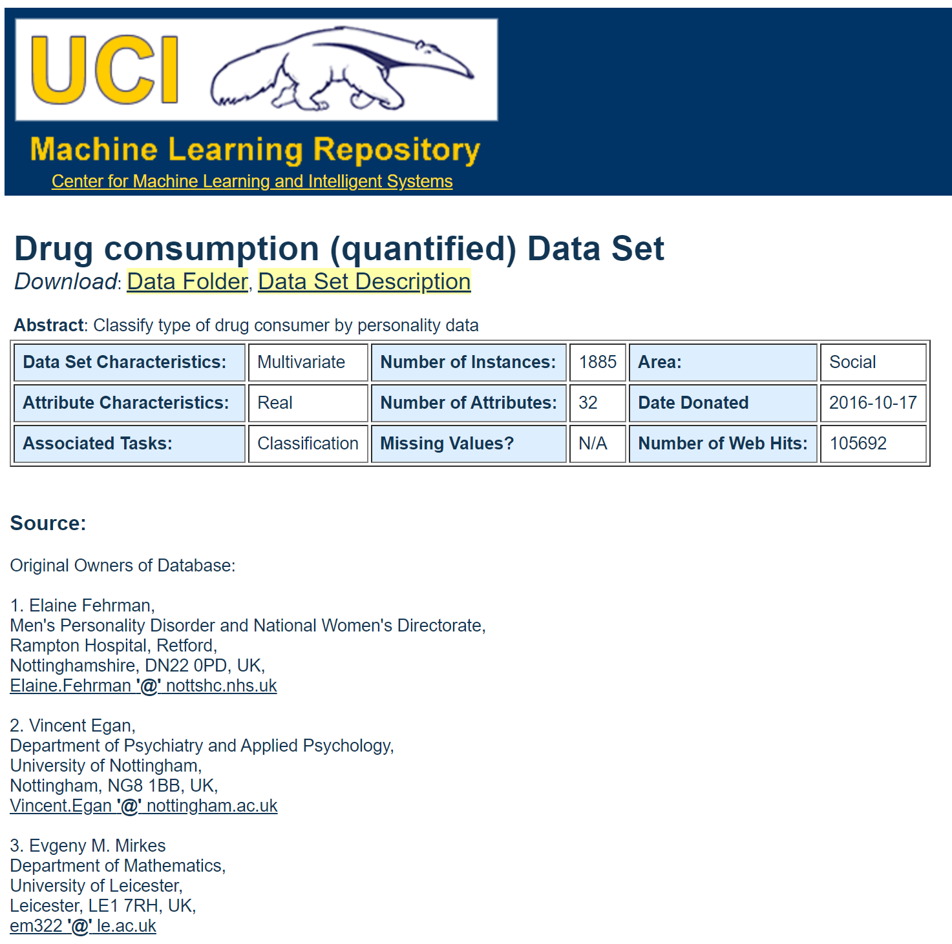

01
Project Introduction
dataset sources | format | overview
Dataset Source
Collected and quantified by Fehrman et al. between March 2011 and March 2012
Available on the UCI Machine Learning Repository
Notes:
what causes a person to become addicted to drugs in the first place?
Elaine Fehrman, Vincent Egan, and Evgeny M. Mirkes viewed this question from a psychological standpoint and collected data from 1885 respondents from over seven countries to evaluate how personality traits and demographics affect drug consumption.

Slide 6
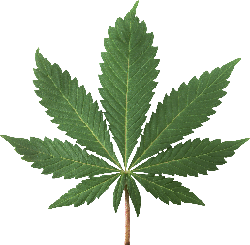
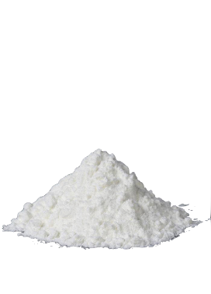
01
Project Introduction
dataset sources | format | overview
Dataset Format
Data was collected from 1885 respondents from over seven countries to evaluate how personality traits and demographics affect drug consumption.
General Info
ID Age Gender Education Country Ethnicity
Personality Measurement Scores
Nscore (score on Neuroticism) Escore (score on Extraversion) Oscore (score on Openness to experience) Ascore (score on Agreeableness) Cscore (score on Conscientiousness) Impulsive (impulsiveness measurement) Sensation (input about the physical world obtained by our sensory receptors)
19 Drug Types
Alc = Alcohol Amphet = Amphetamine Amyl = Amyl Nitrite Benzos = Benzodiazepine Caff = Caffeine Can = Cannabis Choco = Chocolate Coke = Cocaine Crack Ecst = Ecstacy Her = Heroin Ket = Ketamine Leghighs = Legal Highs LSD Meth = Methadone Mush = Magical Mushroom Nico = Nicotine Semeron VSA = Volatile Substance Abuse
Notes:
what causes a person to become addicted to drugs in the first place?
Elaine Fehrman, Vincent Egan, and Evgeny M. Mirkes viewed this question from a psychological standpoint and collected data from 1885 respondents from over seven countries to evaluate how personality traits and demographics affect drug consumption.

Slide 7
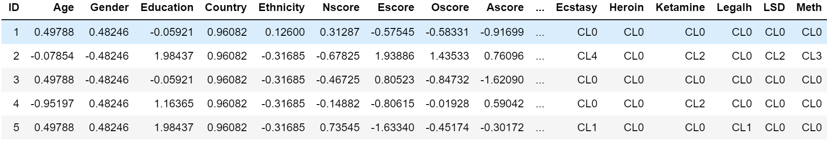
01
Project Introduction
dataset sources | format | overview
1885 rows × 32 columns
All input attributes are originally categorical and are quantified. e.g. 0.48246 = Female -0.48246 = Male
7 Classes For Each Drug
CL0 = never used CL1 = used over a decade ago CL2 = used in last decade CL3 = used in last year CL4 = used in last month CL5 = used in last week CL6 = used in last day

Slide 8

01
Project Introduction
dataset sources | format | overview
Neuroticism
Sadness, anger, anxiety, and emotional instability
High score are prone to mood swings
Extraversion
Assertiveness, sociability, and excitability
High score are described as outgoing
Openness to Experience
Conscientiousness
Creative, open to try new things
High score are described to have broad range of interest
Show good impulse control and act dutifully
High score are described to be achievement-oriented, well organized, and mindful of details
Agreeableness
Kind, affectionate, cooperative, and altruistic
High score are tend to be more compassionate

Slide 9
02
Data Exploration
Summary statistics | manipulation | binary classification | visualization

Slide 10
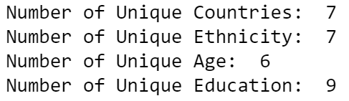
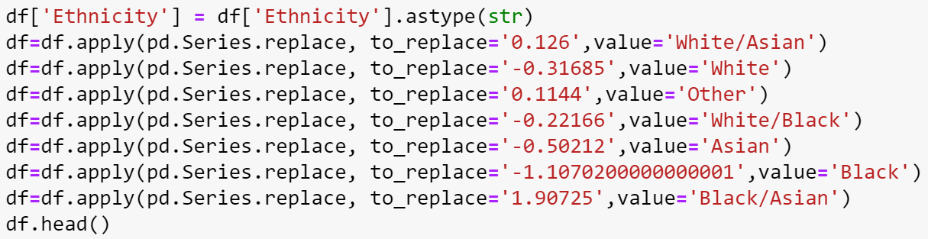
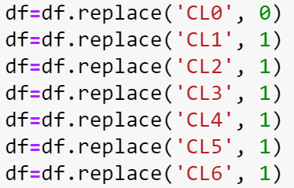
02
Data Exploration
Summary statistics | manipulation | binary classification | visualization
Basic Statistics
Numeric to Categorical
Binary Classification

Slide 11
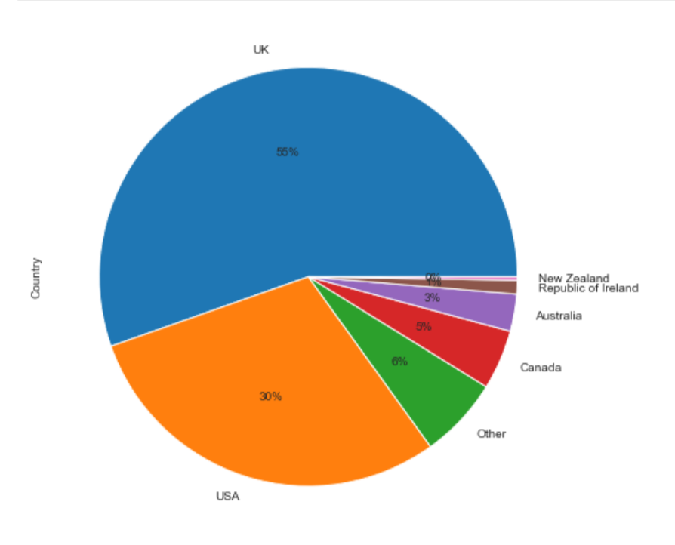
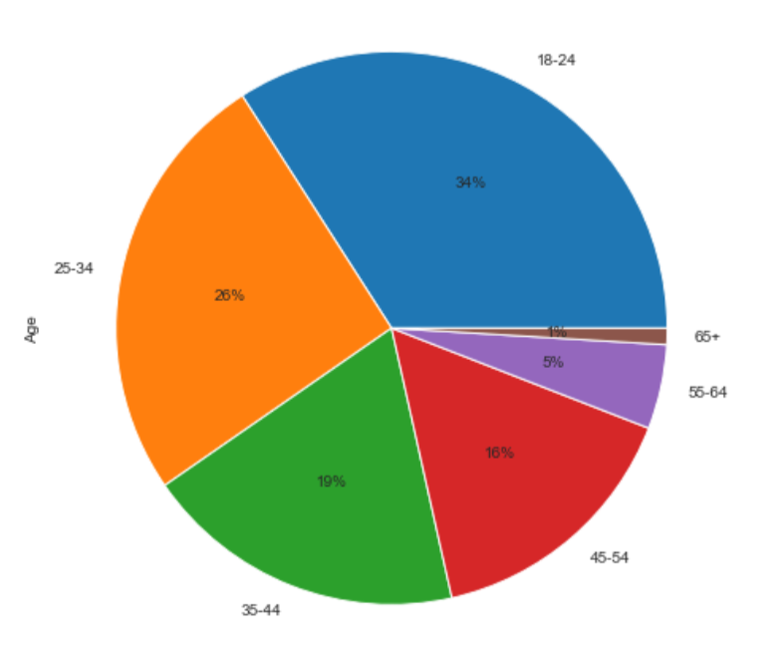
02
Data Exploration
Summary statistics | manipulation | binary classification | visualization
Country
Age

Slide 12
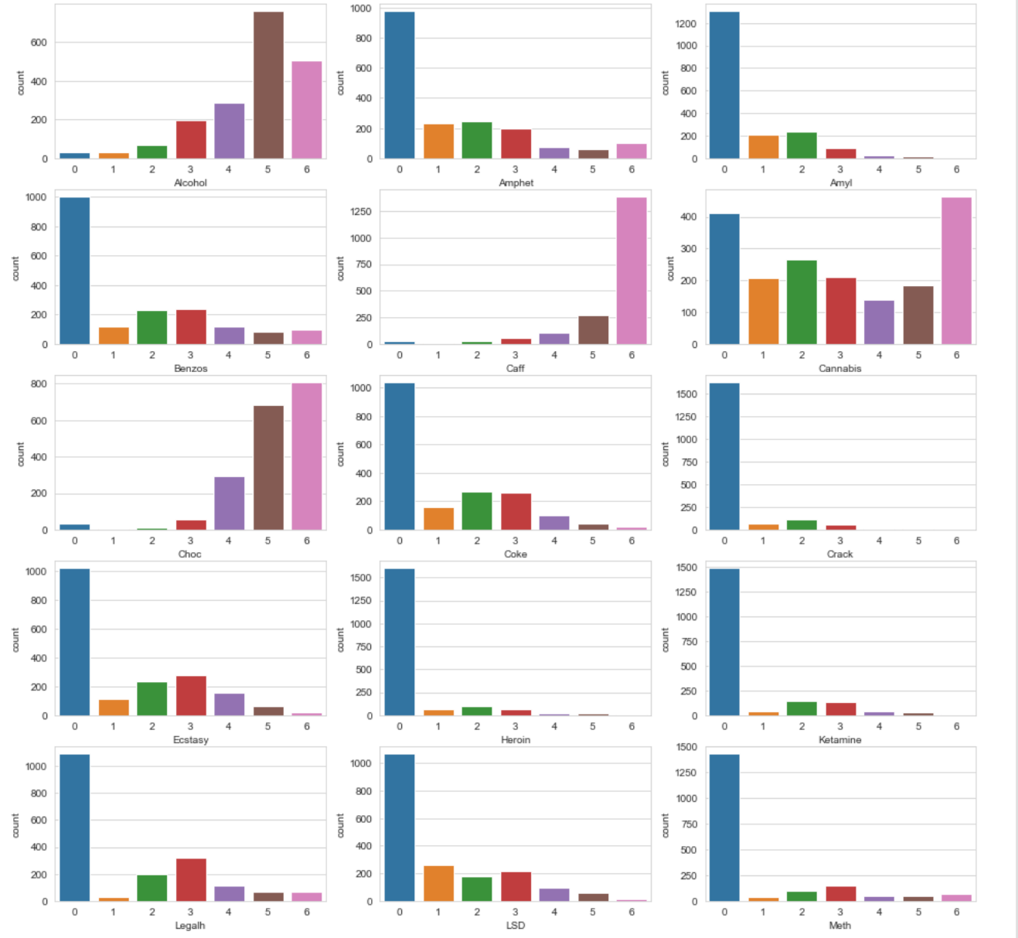
02
Data Exploration
Summary statistics | manipulation | binary classification | visualization
Observation Count by Drug Type

Slide 13
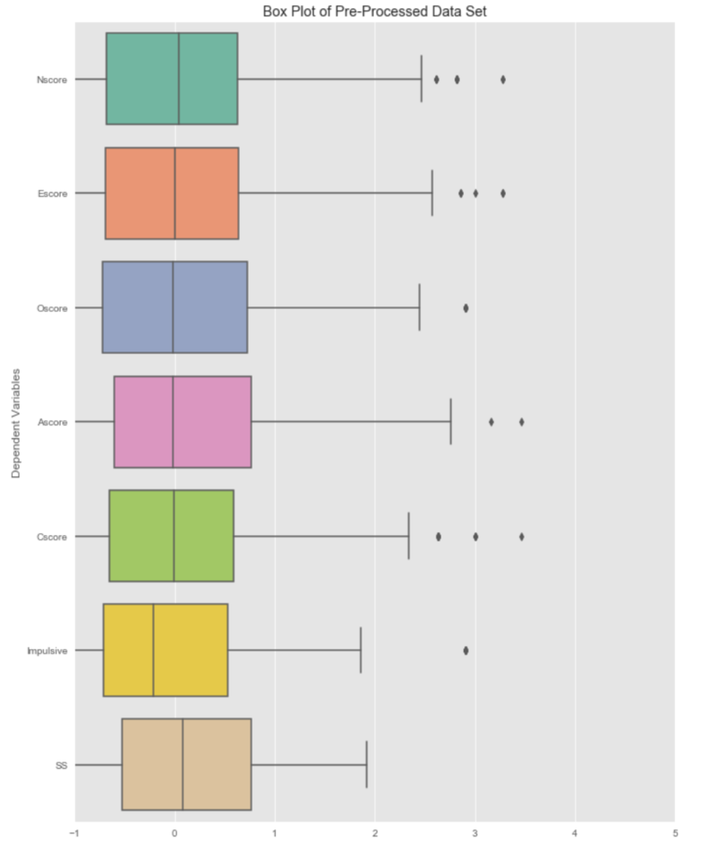
02
Data Exploration
Summary statistics | manipulation | binary classification | visualization
Boxplot For
Each Personalities

Slide 14
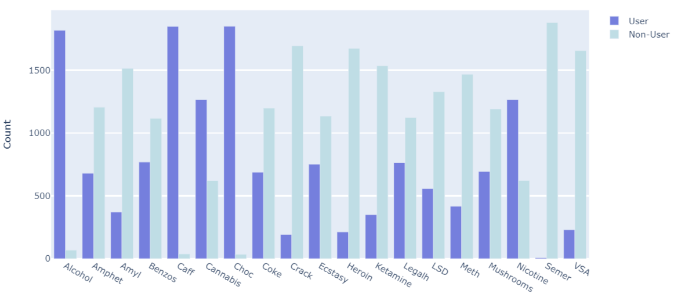
02
Data Exploration
Summary statistics | manipulation | binary classification | visualization
User vs. Non-user by Drug Type

Slide 15
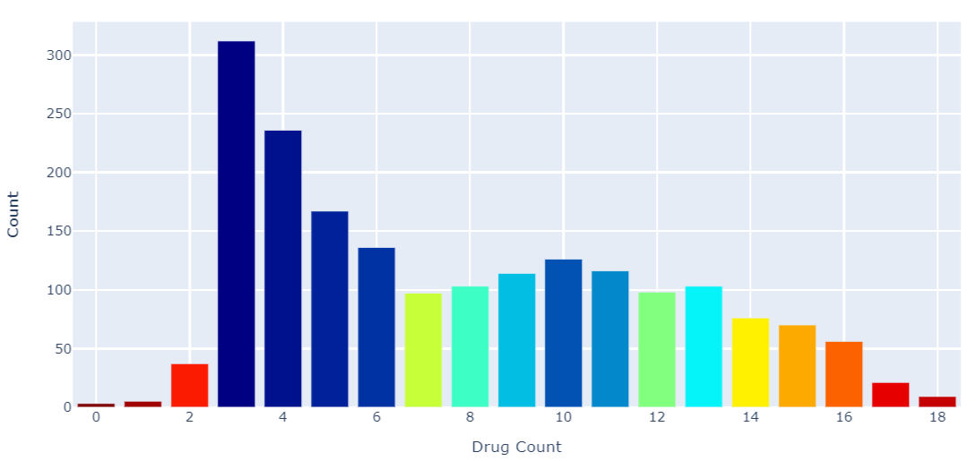
02
Data Exploration
Summary statistics | manipulation | binary classification | visualization
How Many Type of Drugs Users Had Used?

Slide 16
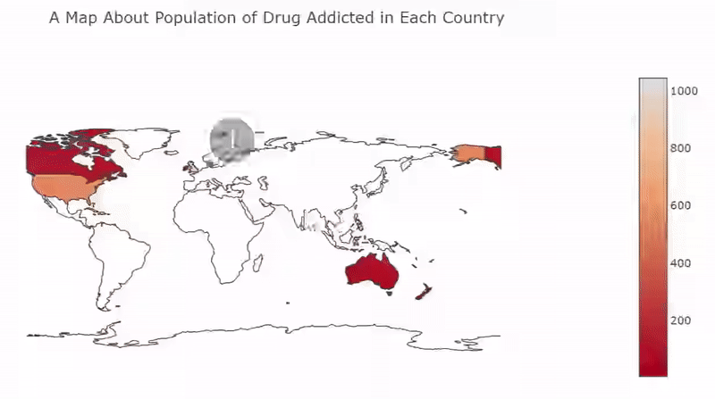
02
Data Exploration
Summary statistics | manipulation | binary classification | visualization

Slide 17
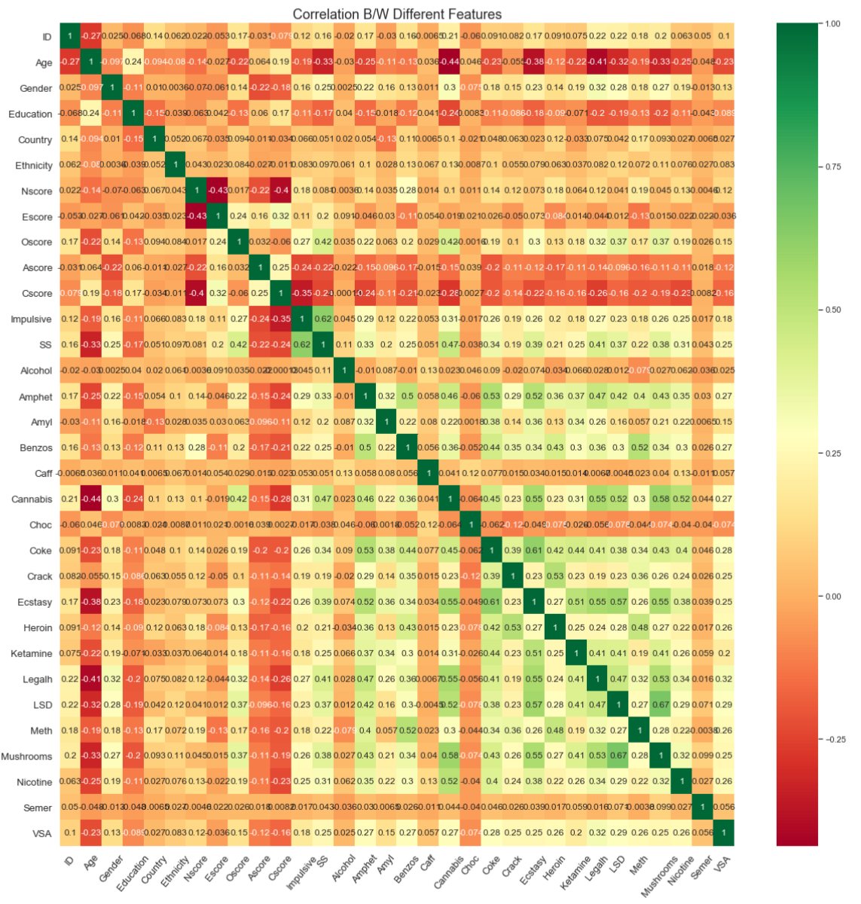
02
Data Exploration
Summary statistics | manipulation | binary classification
| visualization
Correlation Between
Different Features

Slide 18
03
Model Analysis

Slide 19

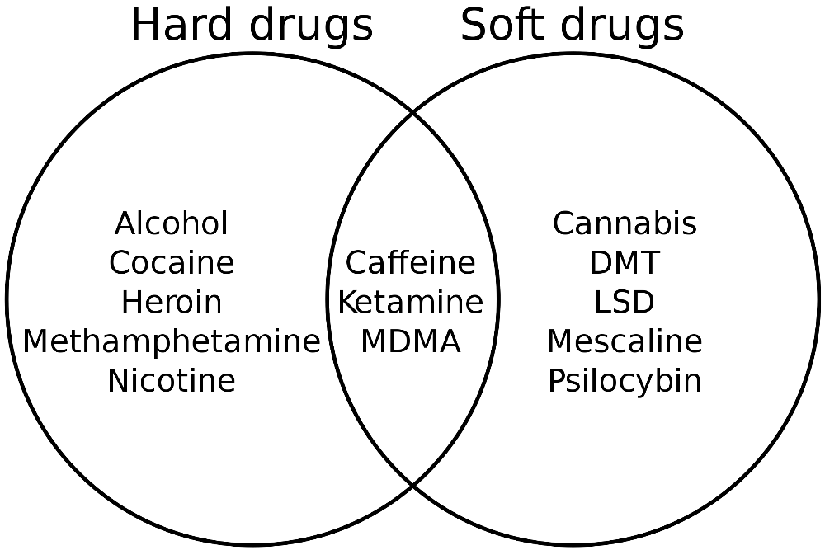


03
Model Analysis I
KNN | logistic regression | linear SVC | kernel SVC | decision tree
Hard drug
Alcohol
Soft drug
Cannabis
In between
Caffeine

Slide 20
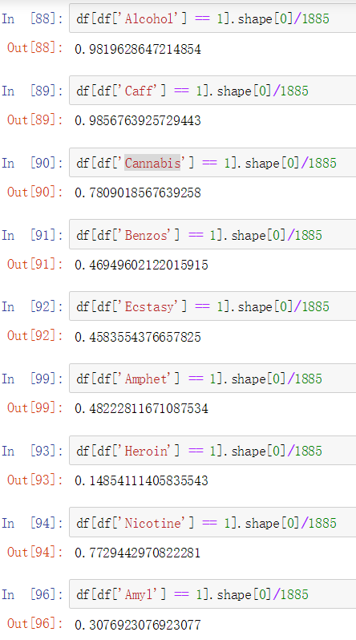
KNN
Logistic Regression
Linear SVC
Kernel SVM
Decision Tree

Slide 21
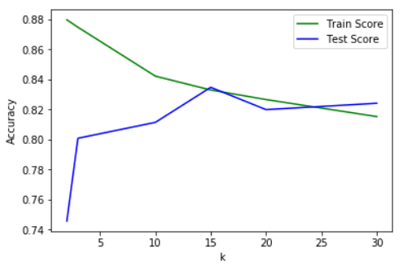
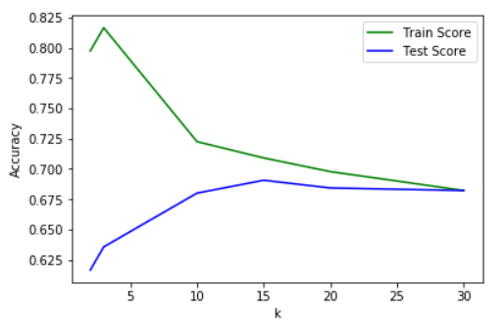
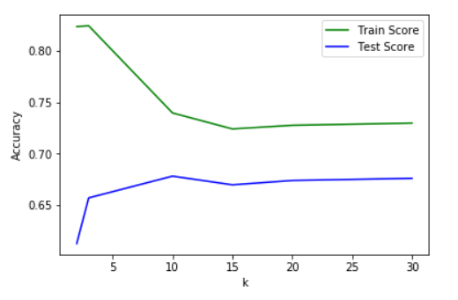
CV-Grid Search for KNN Classifier
Cannabis
Best parameters: {'n_neighbors': 10}
Best cross-validation score: 0.808
Benzos
Best parameters: {'n_neighbors': 20}
Best cross-validation score: 0.660
Ecstasy
Best parameters: {'n_neighbors': 20}
Best cross-validation score: 0.706

Slide 22
Model name | Hyper-parameters | Model Score
KNeighborsClassifier | k = 10 | 0.808
LogisticRegression | C = 10 | 0.815
LinearSVC | C = 0.1 | 0.812
kernel SVM | C = 0.1 gamma = 1 kernel = ’poly' | 0.815
Decision Tree | max_depth = 1 | 0.785
Cannabis
Benzos
Model name | Hyper-parameters | Model Score
KNeighborsClassifier | k = 20 | 0.660
LogisticRegression | C = 10 | 0.672
LinearSVC | C = 0.1 | 0.670
kernel SVM | C = 1 gamma = 1 kernel = ’poly' | 0.676
Decision Tree | max_depth = 3 | 0.660
Ecstasy
Model name | Hyper-parameters | Model Score
KNeighborsClassifier | k = 20 | 0.706
LogisticRegression | C = 10 | 0.718
LinearSVC | C = 10 | 0.720
kernel SVM | C = 1 gamma = 0.01 kernel = ’linear' | 0.720
Decision Tree | max_depth = 3 | 0.684

Slide 23
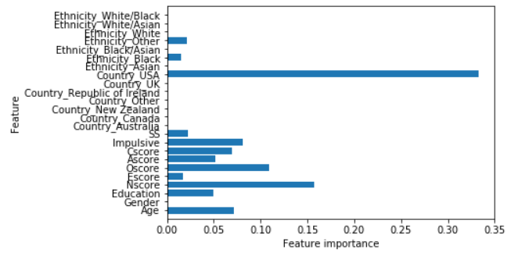
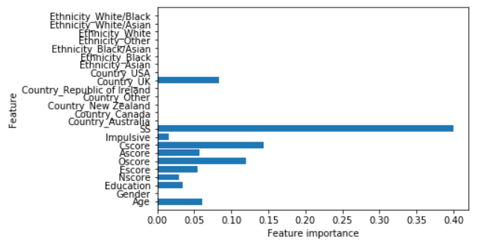
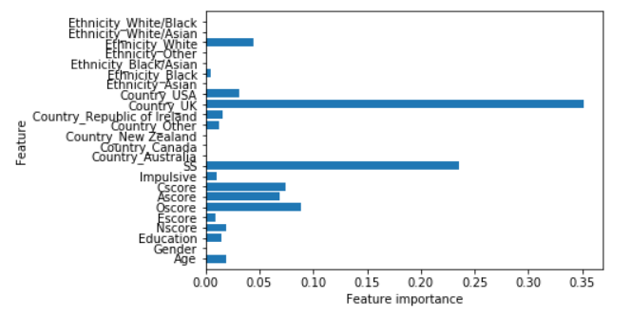
Benzos Ecstasy
Cannabis

Slide 24
03
Model Analysis II
Decision Tree| Neural Network | Random Forest| KNN|
Hard drug
Alcohol
Soft drug
Cannabis
In between
Caffeine
Notes:
Moving further, besides predicting whether a user used a drug or not, we’d also like to predict the drug consumption history of users. When we are talking about drug consumption history, we are talking about in how long the past the user did take the drug. Is it a decade ago, a year ago, a month ago or a day ago.
Because there are so many drugs in our dataset, use models on all of them is unnecessary. So we chose 3 drugs for our model analysis which are Alcohol, Caffeine and Cannabis. They are the most popular ones(right now) and have the biggest druggie numbers.

Slide 25
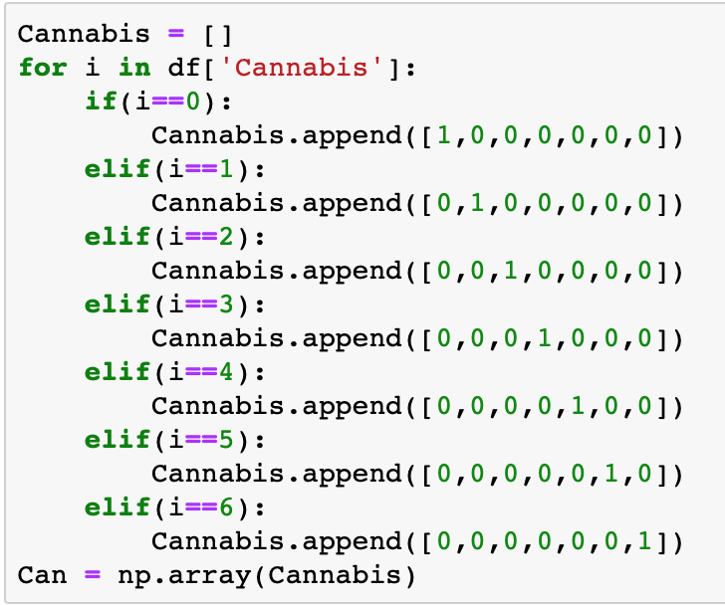
03
Model Analysis II
Decision Tree| Neural Network | Random Forest| KNN|
Notes:
When we look into the value of each drug cell by cell, we will find the drug consumption history is a degree. So In order to predict a degree we have to create a dummy variable for each these 3 drugs we chose. For Cannabis, we created a dummy variable “Can” which is a list. As we can see there are all these kind of zero and one out here, the index/position of each “1” represents the original value of the cell. For example, if we put “1” in the 3rd position, the original value should be 2 which means the user used Cannabis decade ago.
(The code for Alcohol and Caffeine are the same, so I didn’t put it here.)

Slide 26

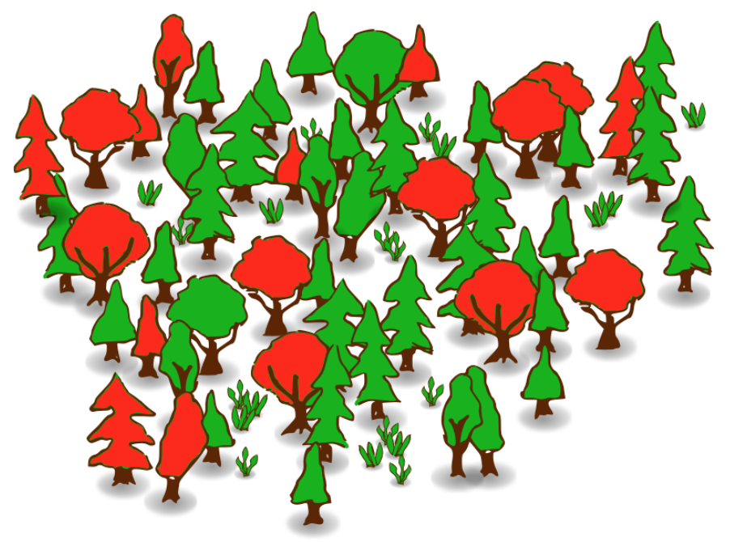
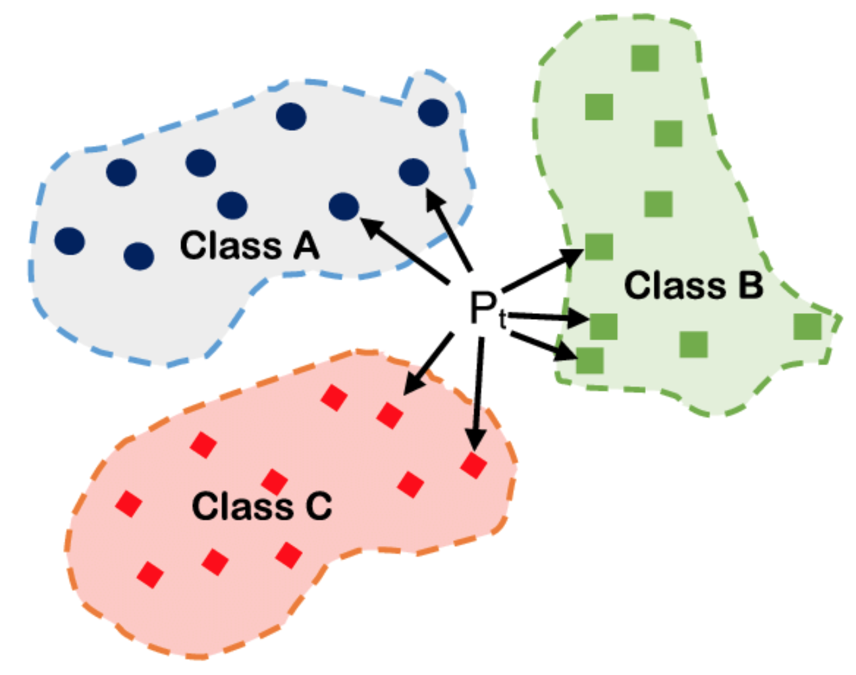
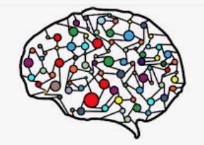
03
Model Analysis II
Decision Tree| Neural Network | Random Forest| KNN|
Decision Tree
Random Forest
KNN
Neural Network
Notes:
I chose these 4 models (Because I am using dummy variable as my target variable which made my X and Y not linearly dependent on each other anymore, so all the linear models become unavailable in my case.)

Slide 27
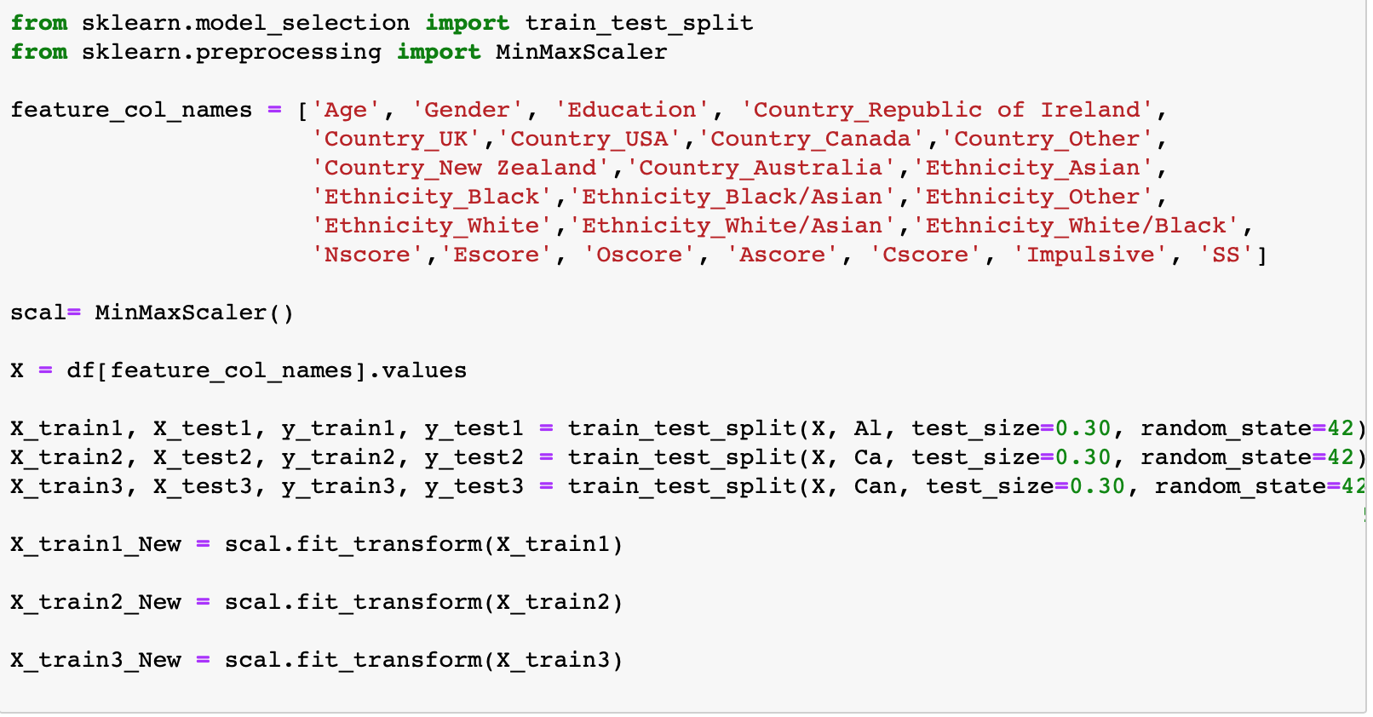
03
Model Analysis II
Decision Tree| Neural Network | Random Forest| KNN|
Notes:
The first step for model training as you know, is splitting the dataset.
I chose all these kind of features to be my X to predict on my target and my targets are the dummy variables I created before.

Slide 28
03
Model Analysis II
Decision Tree| Neural Network | Random Forest| KNN|
Decision Tree
01
I used grid search in each case
Drug | Accuracy on Test | Accuracy on Training
Alcohol | 0.981 | 0.983
Caffeine | 0.988 | 0.985
Cannabis | 0.783 | 0.780
02
03
Feature Importance
Notes:
There are couple things I want to mention about

Slide 29
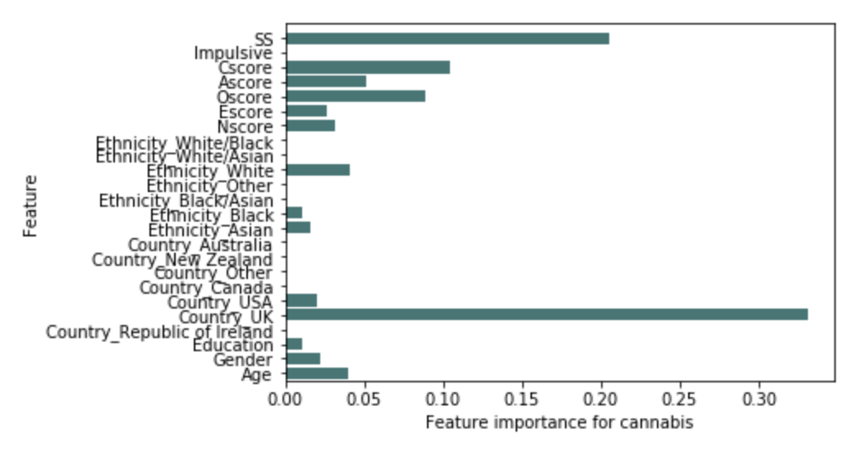
03
Model Analysis II
Decision Tree| Neural Network | Random Forest| KNN|
Notes:
The length of bars represent its importance, the longer, the greater influence the feature has.
So, from this figure we can tell the country UK has the greatest influence on our model (People in UK are more likely to do cannabis)

Slide 30
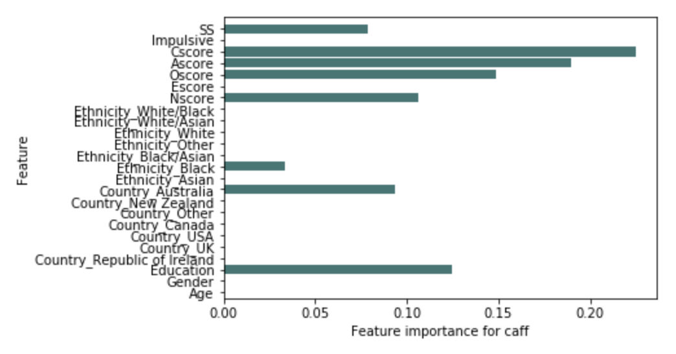
03
Model Analysis II
Decision Tree| Neural Network | Random Forest| KNN|
Notes:
People get high Cscore (Conscientiousness) are more likely to do caffeine

Slide 31
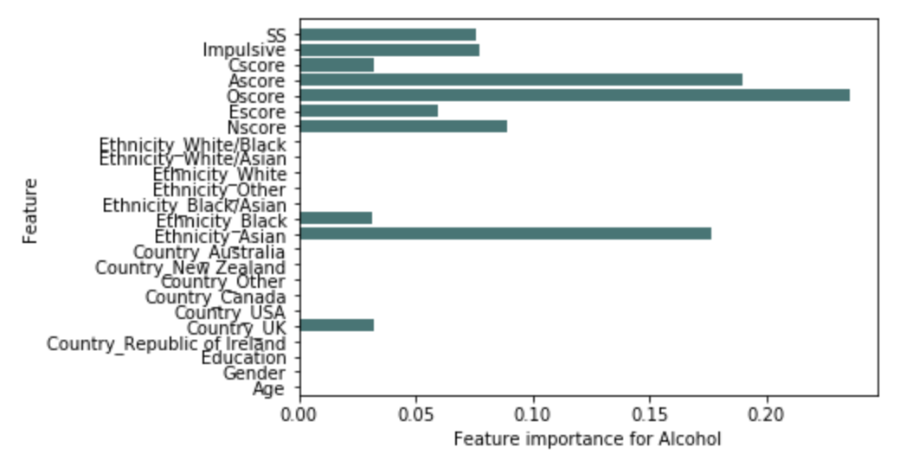
03
Model Analysis II
Decision Tree| Neural Network | Random Forest| KNN|
Notes:
People get high Oscore (openness) are more likely to do alcohol and Asian people seems like drink a lot alcohol too!

Slide 32
03
Model Analysis II
Decision Tree| Neural Network | Random Forest| KNN|
Random Forest
01
I used same parameters from decision tree
Drug | Accuracy score
Alcohol | 0.98057
Caffeine | 0.98763
Cannabis | 0.78269
02

Slide 33
03
Model Analysis II
Decision Tree| Neural Network | Random Forest| KNN|
Neural Network
01
Classifier = Sequential
Drug | Accuracy | loss
Alcohol | 0.9951 | 0.0203
Caffeine | 0.9951 | 0.0180
Cannabis | 0.9422 | 0.1152
02
Notes:
I chose the sequential as my classifier which means I will build my whole neural network by adding layers sequentially like one by one.

Slide 34
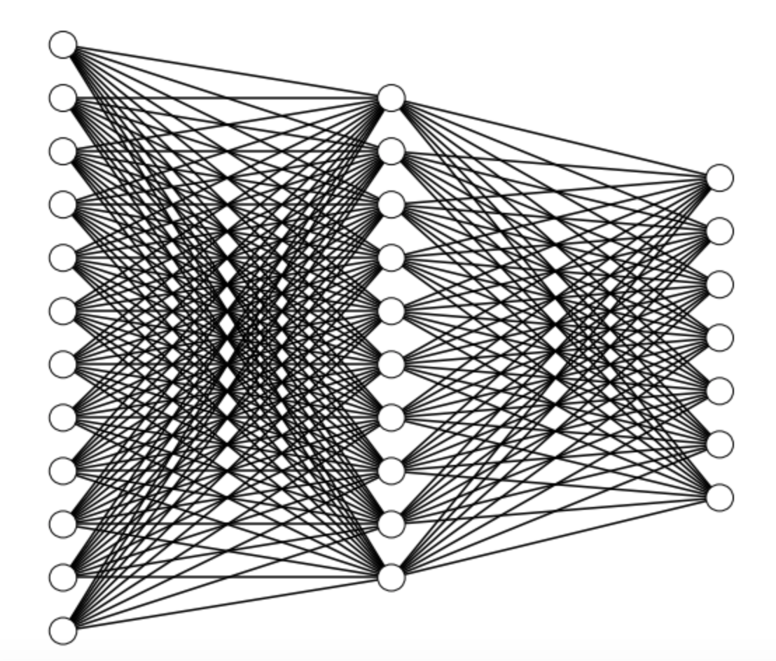
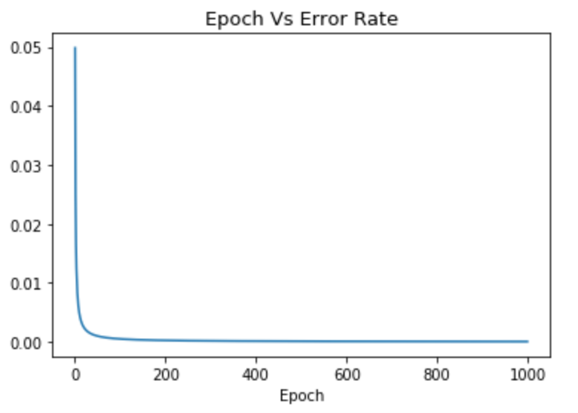
03
Model Analysis II
Decision Tree| Neural Network | Random Forest| KNN|
Notes:
The left one is the epoch verse error rate, as we can see as the epoch increasing, the error rate of our model will decrease like dramatically. And when the epoch reaches a bar or a number, our error rate remains the same at a very low level. The right one is how our neural network looks like.

Slide 35
03
Model Analysis II
Decision Tree| Neural Network | Random Forest| KNN|
KNN
01
Grid search for each drug
Drug | Best K | Best Cross-validation score
Alcohol | 3 | 0.983
Caffeine | 5 | 0.985
Cannabis | 9 | 0.802
02

Slide 36
03
Model Analysis II
Decision Tree| Neural Network | Random Forest| KNN|
Drug | Model | Accuracy
Alcohol | Decision Tree | 0.981
 | Neural Network | 0.9951
 | Random Forest | 0.98057
 | KNN | 0.983
Caffeine | Decision Tree | 0.988
 | Neural Network | 0.9951
 | Random Forest | 0.98763
 | KNN | 0.985
Cannabis | Decision Tree | 0.783
 | Neural Network | 0.9422
 | Random Forest | 0.78269
 | KNN | 0.802
Model Evaluation
Notes:
From all these number above, we can tell Neural Network is the best model for our dataset.

Slide 37

03
Prediction
Name: Lisa
Age: 22
Specialty: Dancing
Gender: Girl
Education: College
Country: Thailand
Ethnicity: Asian
Nscore : 0.31287,
Escore: 0.31287,
Oscore: -0.57545,
Ascore: -0.58331,
Cscore: -0.91699,
Impulsive: -0.00665,
SS: -0.21712
Notes:
I think we not only need to get the accuracy and pick out the best model, we also need to do some prediction by using our best model in order to make our whole project more practical. When we meet a new person, we can ask them for all the information about their age, country, ethnicity, education background and etc. For all these score number, we can ask them to fill out some questionnaire and we calculate their results and get those numbers. After we get all the data we need, we can put our best model on it and do the prediction like get to know in how long the past this person did drug.

Slide 38
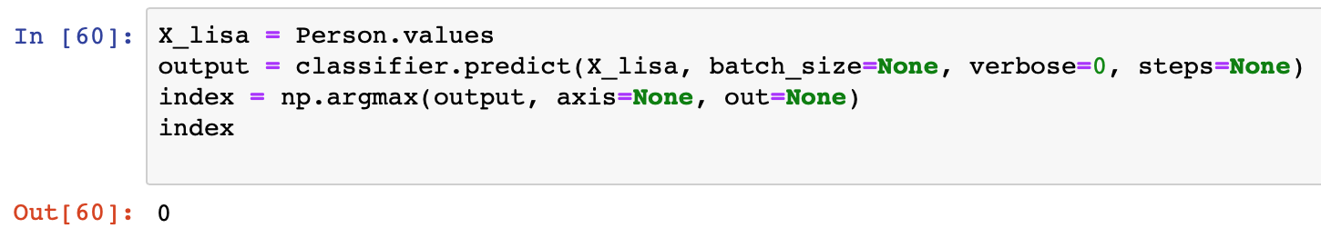

03
Prediction
Good Girl !!!
Notes:
The classifier in this case is the classifier we trained on the drug cannabis.
The “output” is an np array, each element within this np array represents the possibility of “1” occurs on its position. “Index” returns the index/position of the maximum possibility of one occurs which in this case is zero. So, we can say the “one” will most likely appear at the index zero which mean Lisa never used Cannabis before.

Slide 39
THANKS！
Q&A TIME
Qianying Li | Xinyi Chen | Hao Mei | Chuang Chen

